Slide 1



SESSION NAME HERE
LINEAR DATA STRUCTURES (Part 2)

Slide 2


Foundational Sessions Housekeeping
The use of disrespectful language is prohibited in the questions, this is a supportive, learning environment for all - please engage accordingly. (FBV: Mutual Respect.)
No question is daft or silly - ask them!
There are Q&A sessions midway and at the end of the session, should you wish to ask any follow-up questions. Moderators are going to be answering questions as the session progresses as well.
If you have any questions outside of this lecture, or that are not answered during this lecture, please do submit these for upcoming Open Classes. You can submit these questions here:
SE Open Class Questions or DS Open Class Questions

Slide 3
Foundational Sessions Housekeeping cont.
For all non-academic questions, please submit a query: www.hyperiondev.com/support
Report a safeguarding incident: www.hyperiondev.com/safeguardreporting
We would love your feedback on lectures: Feedback on Lectures

Slide 4


Reminders!
Guided Learning Hours
By now, ideally you should have 7 GLHs per week accrued. Remember to attend any and all sessions for support, and to ensure you reach 112 GLHs by the close of your Skills Bootcamp.
CONFIDENTIAL

Slide 5
Progression Criteria
✅ Criterion 1: Initial Requirements
Complete 15 hours of Guided Learning Hours and the first four tasks within two weeks.
✅ Criterion 2: Mid-Course Progress
Software Engineering: Finish 14 tasks by week 8.
Data Science: Finish 13 tasks by week 8.
✅ Criterion 3: Post-Course Progress
Complete all mandatory tasks by 24th March 2024.
Record an Invitation to Interview within 4 weeks of course completion, or by 30th March 2024.
Achieve 112 GLH by 24th March 2024.
✅ Criterion 4: Employability
Record a Final Job Outcome within 12 weeks of graduation, or by 23rd September 2024.
CONFIDENTIAL

Slide 6

Linear Data Structures
Stacks
Queues
Priority Queues

Slide 7

Stacks
Method of Ordering
LIFO: Last element added to the stack is the first to be removed
Elements are added on top of one another in a “stack”
A pointer points to the element at the top of the stack
Operations
Push: Adds an element to the top of the stack
Pop: Removes the element from the top of the stack
PUSH
POP
Item 4
Item 4
Item 4
Item 3
Item 2
Item 1
Item 4
Item 3
Item 2
Item 1
top
top

Slide 8
Stacks
Complexity Analysis
Push
Space: O(1)
No extra space is used
Time: O(1)
A single memory allocation
done in constant time
Common Uses
Function and Recursive Calls
Undo and Redo Mechanisms
“Most recently used” features
Pop
Space: O(1)
No extra space is used
Time: O(1)
Pointer is decremented by 1
Backtracking algorithms
Expression evaluations and syntax parsing

Slide 9
Queues
Method of Ordering
FIFO: First element added to the stack is the first to be removed
Elements added to rear of a “queue” and removed from front
Two pointers point to the front and the rear
Operations
Enqueue: Adds an element to the end of the queue
Dequeue: Removes the element from the front of the queue
front
back
DEQUEUE
ENQUEUE
Item 1 | Item 2 | Item 3 | Item 4 | Item 5
Item 1
Item 5

Slide 10
Queues
Complexity Analysis
Enqueue
Space: O(1)
No extra space used
Time: O(1)
Single memory allocation
done in constant time
Common Uses
Task Scheduling
Resource Allocation
Network Protocols
Dequeue
Space: O(1)
No extra space used
Time: O(1)
Front pointer incremented by 1 and node deallocated
Printing Queues
Web Servers
Breadth-First Search

Slide 11
Priority Queues
Method of Ordering
Arranged according to the assigned priority of elements
Order direction doesn’t matter, as long as the highest priority elements are removed first
Operations
Enqueue: Adds an element to the queue based on its priority
Dequeue: Removes the highest priority element from the queue
front
back
DEQUEUE
ENQUEUE
Item 2 P: 10 | Item 3 P: 8 | Item 1 P: 7 | Item 5 P: 4 | Item 4 P: 1
Item 2 P: 10
Item 5 P: 4
Notes:
Order direction - referring to whether the list starts with the highest priority element or the lowest

Slide 12
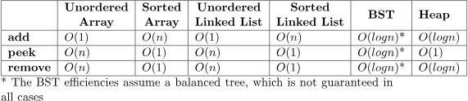
Priority Queues
https://www.baeldung.com/cs/priority-queue
Notes:
Depends on implementation but going off of our implementation

Slide 13
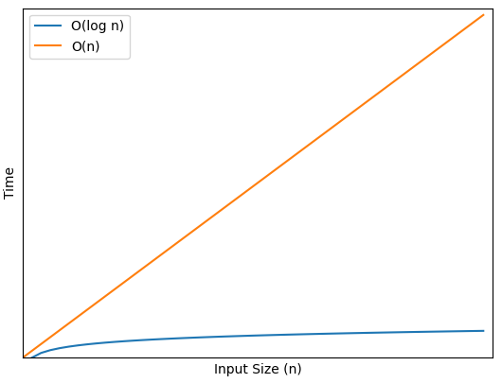
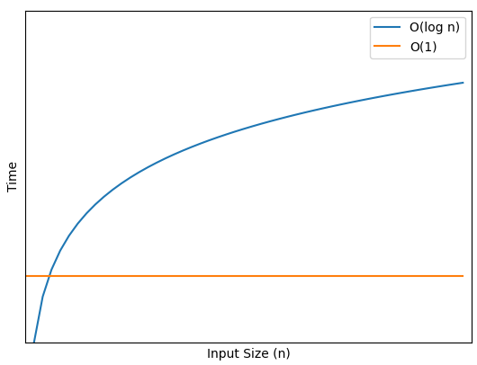
Priority Queues
Complexity Analysis Visualisation
Enqueue Time Complexity
Dequeue Time Complexity
Notes:
Depends on implementation but going off of our implementation

Slide 14
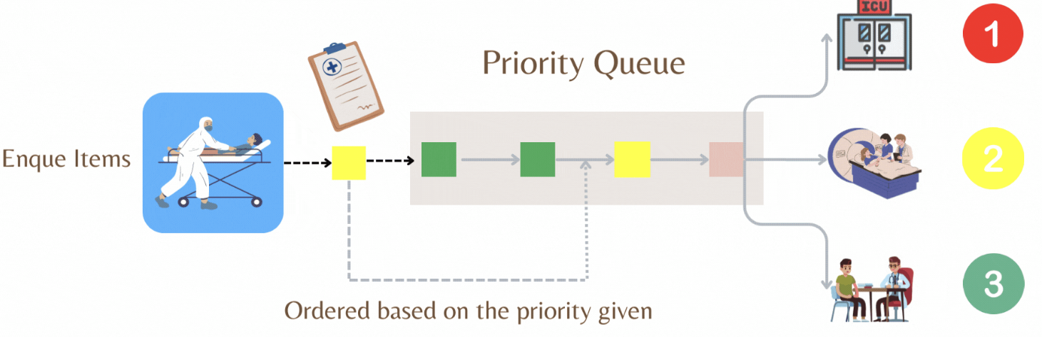
Priority Queues
Common Uses
Dijkstra’s Shortest Path Algorithm
Data Compression
Artificial Intelligence
Load Balancing in OSs
Optimisation Problems
Robotics
Medical Systems
Event-driven simulations
Source: Priority Queues in Healthcare (Medium)
Notes:
Depends on implementation but going off of our implementation

Slide 15
Linear Data Structures
Introduction to Hash Tables
Hash Collisions
Implementing a Hash Table
Comparing Hash Tables and Dictionaries
Hash Table Use Cases

Slide 16
Hash Tables
A data structure that is used to store key-value pairs which uses a hash function to transform the key into the index of an associated array element where the data will be stored.
Hash tables allow for efficient and fast insertions, deletions and look-ups due to the manner in which values are stored.
Since the index where the values is stored is a function of the value, the position where the value must be stored is always known.
key1
key2
key3
key4
key5
0
1
2
3
4
hash fn
Notes:
Note that hash functions may be one-way (hash doesn’t generate the original data item) which is important in cryptography

Slide 17

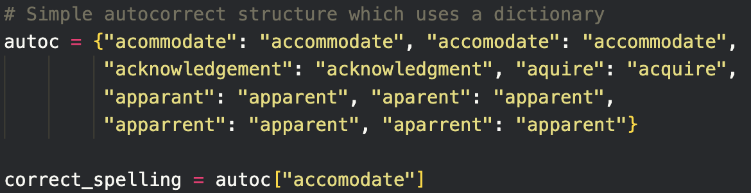
Example: Dictionaries in Python
The data structure known as a dictionary is a data structure that can easily solve our problem. In a dictionary, key-value pairs are stored and values are accessed using the key value.
It turns out that this data structure is very efficient, but how does it work? How is it so efficient?

Slide 18
Hashing refers to using the hash function to calculate the hash which is the index of the array element where the key-value pair will be stored.
Each array element is called a bucket or slot and can store one or more key-value pairs.
The hash function can be any deterministic function which maps a key to the range of indices but the aim is that the function is efficient, it distributes keys uniformly and multiple keys being mapped to the same index is avoided.
The load factor is the ratio of the number of stored elements to the total number of buckets and is used to determine whether the table can be downsized to improve performance.
Notes:
Last two + hash collisions are the deciding factors when it comes to time complexities
Demo: https://www.md5online.org, insert a text of any length in the textbox, click the crypt button and get your 128bit MD5 hash back.

Slide 19
Hash Collisions
When two or more distinct keys hash to the same array index.
Although we try to avoid hash collisions, they are inevitable so we have to implement a collision-resolution process.
When searching or storing data, a hash collision increases the time complexity of the task.
Operation | Average Case | Worst Case
Insert | O(1) | O(n)
Lookup/Search | O(1) | O(n)
Delete | O(1) | O(n)

Slide 20
Collision-Resolution Methods
Chaining: Linked Lists are used for each bucket, so multiple key-value pairs can be stored in the same bucket.
Pros: Simple to implement, dynamic resizing
Cons: Memory overhead implications, space inefficiencies
Linear Probing: If there is a collision, place the pair in the next available slot in the hash table (linearly).
Pros: Simple to implement, memory-efficient
Cons: Primary clustering (large blocks of occupied elements), clustering results in more time inefficiencies

Slide 21
Hash Tables vs Dictionaries
Dictionaries are data structures which store key-value pairs.
They are implemented internally using a hash table, which makes use of Python’s built-in hash function.
Dictionaries are the easiest way to implement a hash table in Python, since all the complexities involved in ensuring efficiency is abstracted away and is done for us.
A custom hash table would be primarily used when a custom hash function needs to be implemented.
This is useful in the case where keys are of custom or non-hashable data types.

Slide 22


Hash Tables Use Cases

Slide 23
Hash Tables Use Cases
Databases:Databases employ hash tables for indexing, allowing data to be retrieved quickly.
Compilers: Hash tables store identifiers in compilers, aiding in quicker access and processing of instructions.
Cache Memory: Hardware implementations use hash tables to organise cache memory and expedite lookup time.
Networking: Hash tables enable efficient routing information storage in the implementation of routing protocols.
File Systems: In operating systems, hash tables assist in file retrieval by storing file paths and reference

Slide 24
Performance Comparison
Numpy Array
Access: O(1)
Append: O(n) - when creating new array.
Delete: O(n)
Iteration: O(n), but faster due to contiguous memory and cache efficiency.
Vectorized Operations: O(n)
Python List
Access: O(1)
Append: O(1)
Delete: O(n)
Iteration: O(n), but slower, especially on large data sets.
Vectorized Operations: Not supported.

Slide 25


Thank you
for joining us
Take regular breaks
Stay hydrated
Avoid prolonged screen time
Practice good posture
Get regular exercise
“With great power comes great responsibility”

Slide 26


Questions and Answers
Questions around Non-Linear Data Structures Part 2

